Slide 1

Time Series Classification
With KNN + DTW
under Big Data Schema
Big Team - 11
Kunal Choudhary
Harnitha Suresh
Shruti Sundaram
Emaan Bashir
Aishwarya Shahu
Neeraj Thosar
Notes:
Aishwarya – Welcome Panel, Big Team 11 today, presents our project titled “Time Series Classification with KNN+DTW under Big Data Schema”.

Slide 2
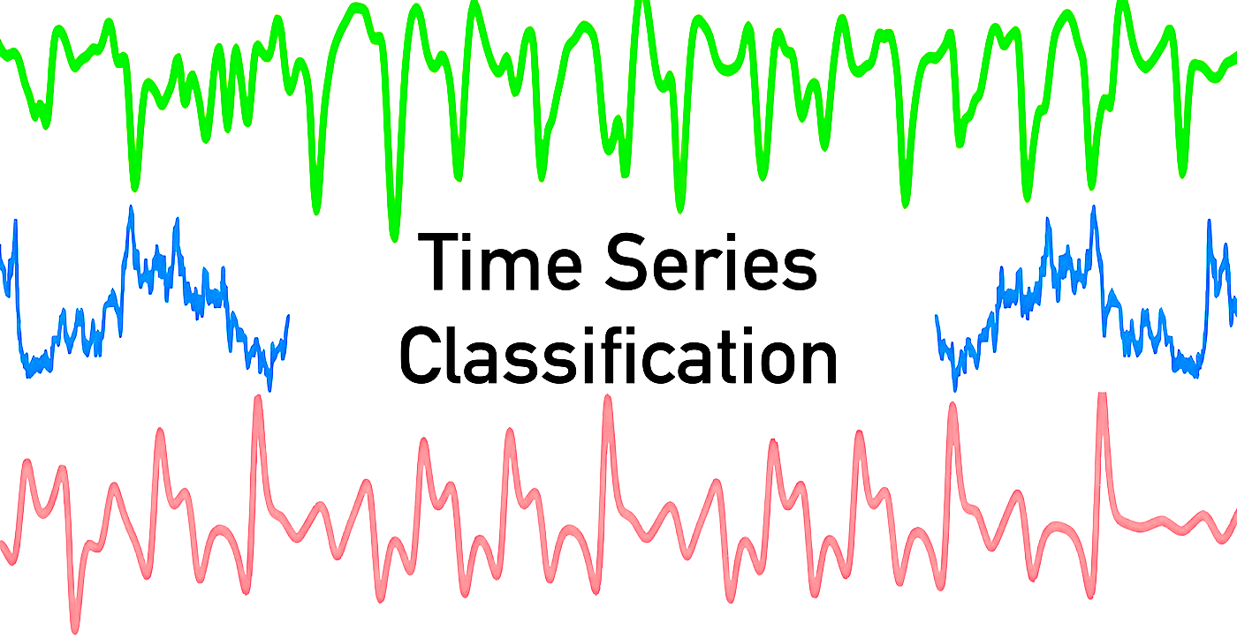
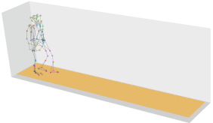
Dataset
Human Activity Recognition (HAR) on Smartphones Time Series
3D Smartphone Accelerometer used to record 6 movements
🪑Sitting
🚶🏻 Walking
🧗🏻 Walking Upstairs
🪜 Walking Downstairs
💤Laying
🧍🏻 Standing
Notes:
Aishwarya - Sensors in everyday gadgets generate vast amounts of data capturing diverse human actions. For this presentation, we are dealing with the Human Activity Recognition dataset where time series of human activities like sitting, walking, walking upstairs –downstairs, standing and lying down were recording using mobile phone sensors.

Slide 3

How big is the data?
We have roughly +7000 time series for training and 3000 for testing (rows).
561 time & frequency domain variables (column).
Tri-axial acceleration & angular velocity from accelerometer & gyroscope.
Notes:
Aishwarya – How big is the data? <read>

Slide 4
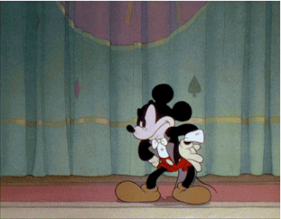
Reduce Waiting Time !
What are we doing?
Building Big-Data solutions to increase computational efficiency for our classification algorithm.
Notes:
Aishwarya - <read>

Slide 5

Why “Big Data” Problem?
~ 5 Vs of Big Data
Notes:
Aishwarya – We now know that the data is huge, but is it huge enough to be a Big data problem?

Slide 6

Volume
Velocity
Variety
Veracity
Value
5 Vs of Big Data
High dimensional data
(561 features)
Huge size
(10,000 time series)
Frequency of data
50 data points every second from one sensor
Unstructured data
Text Files
Multiple Sources
6 sensors.
Noisy
Sensor data might have noise.
Health Care
Elder-care support
Rehabilitation Assistance
Notes:
Shruti – talk about atleast 3 Vs

Slide 7
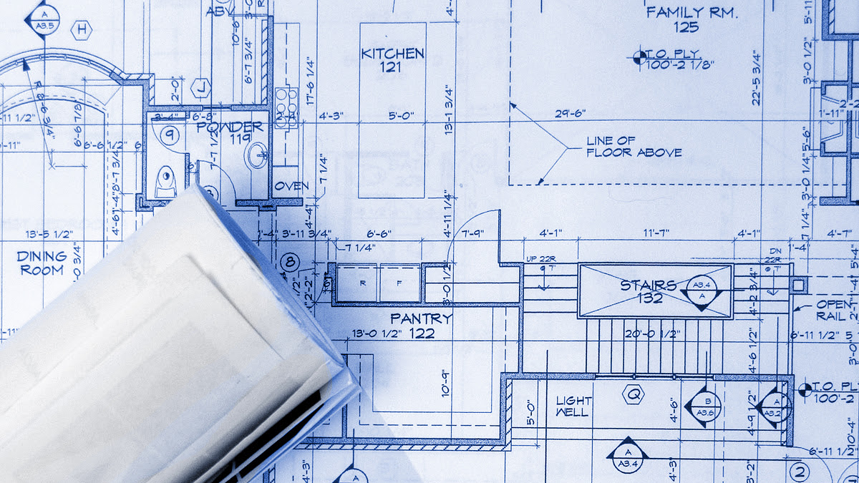
Structural Blueprint
Notes:
Shruti – Let’s look at the structural blueprint of our project.

Slide 8
Workflow
Modelling
Model 1 – Divide & Conquer
Euclidean KNN
Fast-DTW KNN
Data
Pre-processing
Evaluation
Unstructured Text Files
Splitting, data type fix, labelling, SQL tables, vectorize
Performance Accuracy
Run Time
Model 2 – Broadcasting
Fast-DTW KNN
Notes:
Shruti – we first start with raw unstructured data, preprocess it to get dense vectors representing the data. Then we pass this into our model. We have 2 models, first named “Divide and Conquer” and the other “Broadcasting”. Here we apply our K-Nearest Neighbour, a machine learning model. After classification results are ready, we conduct evaluations by looking at accuracy and computation time.

Slide 9

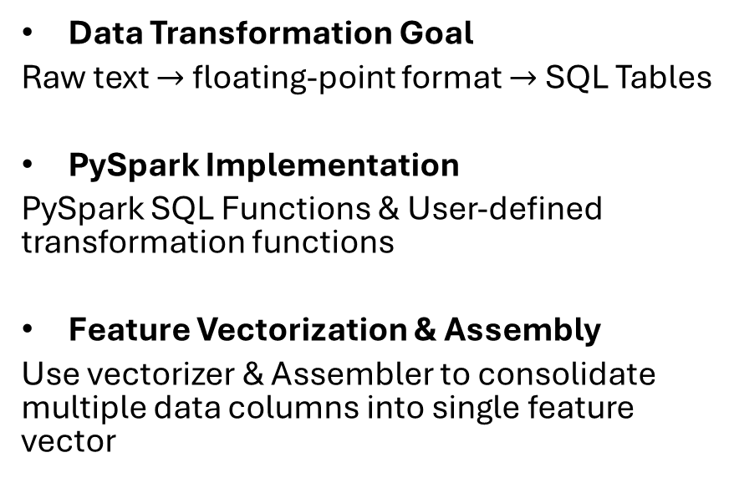
Data Pre-processing
Data Transformation Goal
Raw text $→$ floating-point format $→$ SQL Tables
PySpark Implementation
PySpark SQL Functions & User-defined transformation functions
Feature Vectorization & Assembly
Use vectorizer & Assembler to consolidate multiple data columns into single feature vector
Notes:
Neeraj – Let’s look at how the data is pre-processed. The raw data is a text file, unstructured. We convert it into data frame and then vectorize them using PySpark SQL and UDF functions.

Slide 10


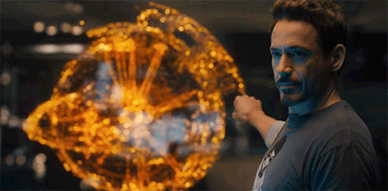
Technology
Why use PySpark SQL Function and not Pandas?
Using Scikit-learn library (64GB RAM + AMD EPYC 7763 64-Core Processor) execution = 1½ a day
PySpark allows Parallel Processing + Effective Resource Management + Real-time Analytics + Database Distribution
We leverage PySpark for parallel processing, database distribution, and handling big data challenges.
What are the “User Defined Functions” we used?
We cannot directly use Python function as they are not supportive of parallelization.
Notes:
Neeraj - <read both questions> Pyspark SQL helps to process data in distributed environment and UDFs enable normal python function to be used in Parallel processing. Pandas is not suitable for parallel processing.

Slide 11

Machine Learning
K - Nearest Neighbours
Euclidean Distances
Fast Dynamic Time Warping Scores
Notes:
Neeraj – the machine learning model we deploy for time series classification is K-nearest neighbours. There are two variants, one using Euclidean distance and the other using DTW. Again, our aim is to reduce computation time for the DTW implementation by using Big data approach.

Slide 12
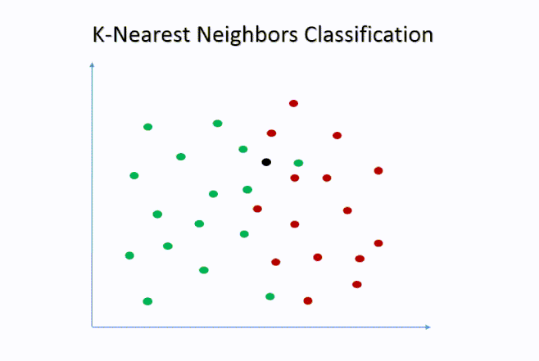
Notes:
Neeraj – A brief overview of how KNN operates. For each point, distance are calculated to find the “k” nearest neighbours. Finally, based on these distances we classify all points.

Slide 13

We have a Lazy Learner !
No training phase – for every prediction, we compute everything again.
Say for a decision tree, we train once, and simply make predictions. Train is complex, but to be done once.
Thus, for KNN we need a stable big-data solution for fast predictions.
Notes:
Neeraj – We have a Lazy Learner. This means that KNN does not have a training phase. For eg, in case of a decision tree, we spend time and train the model and then make predictions. For KNN, all calculation are repeated for making predictions. Thus, we need a stable big-data solution to speed up predictions.

Slide 14
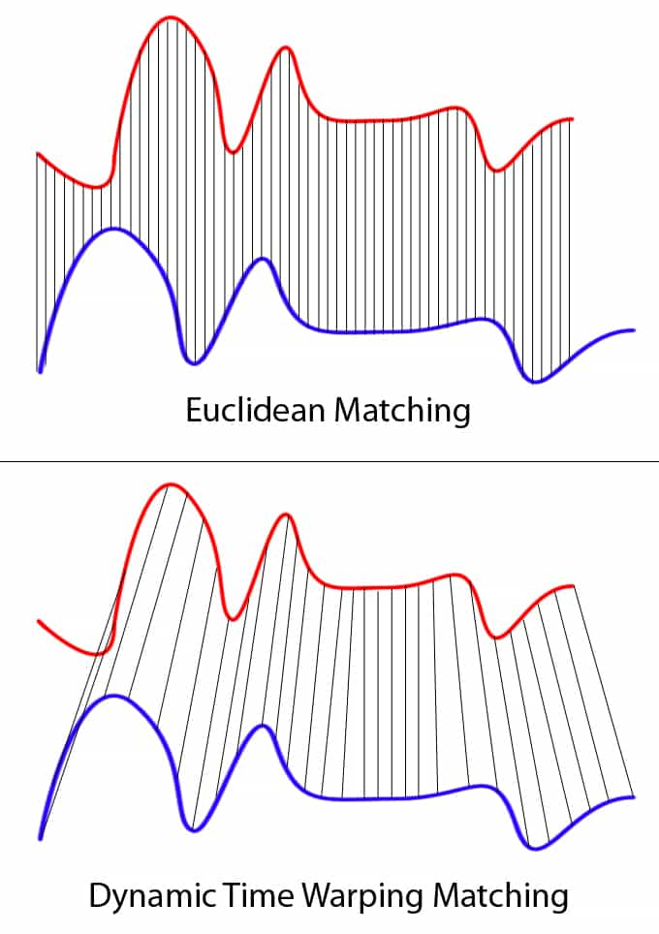



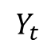
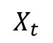
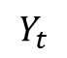
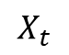
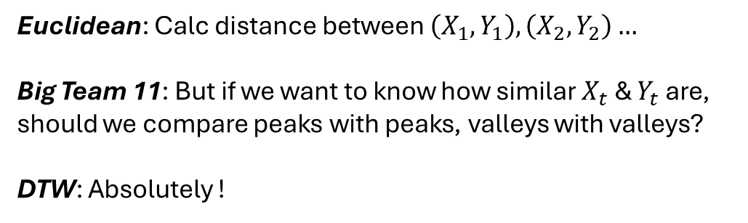
$$X_{t}$$
Euclidean vs. DTW🥊
$$Y_{t}$$
Euclidean: Calc distance between $\left(X_{1}, Y_{1}\right),\left(X_{2}, Y_{2}\right)…$
Big Team 11: But if we want to know how similar $X_{t}$ & $Y_{t}$ are, should we compare peaks with peaks, valleys with valleys?
DTW: Absolutely !
$$X_{t}$$
$$Y_{t}$$
Notes:
Kunal – To calculate distances we have the most popular method, “Euclidean” which says that we should simply calculate the distance between x1 and y1. But then we ponder if comparing peaks with peaks and valleys with valleys make more sense when we seek similarity between two series.

Slide 15
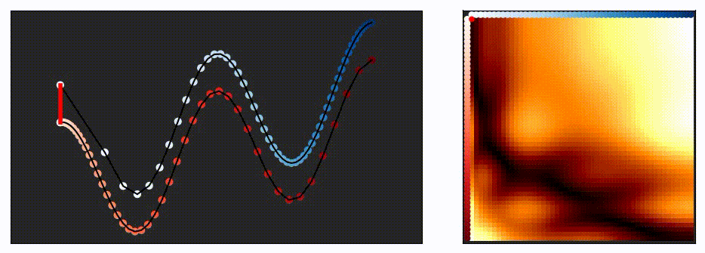

Dynamic Time Warping
The algorithm can be thought of as two frogs hopping from left to right along each time series. Each frog can either stay still or move one spot forward at any time (called warping path). We want to minimize the sum of distance between the frogs over time. This boils down to finding the lowest cost path from upper left to lower right of this matrix on the right.
Notes:
Kunal – this is where Dynamic Time Warping comes into play. The idea here is to find an optimal alignment of our time series such that common features are compared. This is done by calculating a cost matrix (animation of the right).

Slide 16

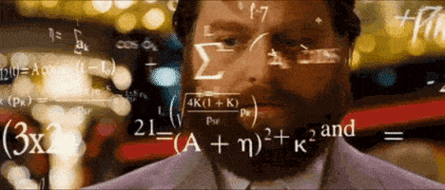
DTW Calculations !?!
Each time series has 561 values. So, the DTW Matrix is 561 x 561. (approx. 314k values)
We have 7000 series. Thus, 7000 matrices i.e., 2.2 billion values. This is for 1 prediction.
We have 3000 predictions to be made.
It is a BIGGG big-data problem!!
Notes:
Kunal – Calculating this cost matrix is cumbersome. <read>

Slide 17

Fast DTW
Fast DTW is optimized version of traditional DTW
Coarse Approximation
Simplify the series, reducing the length.
Recursive Refinement
Calculate path for simpler series. Recursively de-simplify series and refine path.
Radius Constraint
Limit the search width around warping path. Reducing matrix calculations.
Complexity
Accuracy
Scalability
DTW calculations are O(NxM), while Fast DTW O(N)
Trade some accuracy for speed. Good approximation!
Faster computation, well-suited for big-data
Notes:
Kunal – To cut computation, we can make use of a fast approximation called Fast DTW. The idea here is to break the time series into small parts reducing its length. Find optimal paths for these smaller series and then recursively scale up. This limits the matrix calculations.

Slide 18
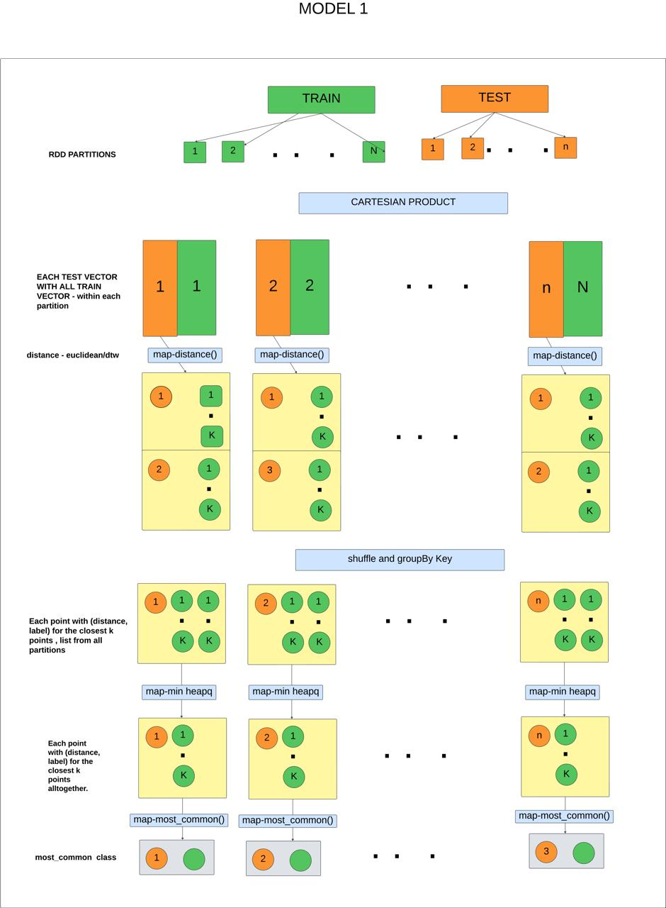
What’s happening inside the Models?
Notes:
Emaan - <read>

Slide 19
Model 1: Divide & Conquer
Notes:
Emaan – we start with splitting train and test data into RDD partitions. This is followed by taking Cartesian products between partitions of train and test. Then we use a map function to calculates distances in each partition and return k smallest distances along with the labels. The distance is calculated either using Euclidean or DTW.
The partitions are done in the driver nodes. The functions applied are dealt by the worker nodes.

Slide 20
Model 1: Divide & Conquer
Euclidean
Fast DTW🏆
Notes:
Emaan – after distances are calculated, we enter the shuffle and group by phase. Here, we group the distance with respect to each test point from all partitions. After sorting these values using heapq we get the closest k labels for the entire dataset and the most common is used as the prediction.

Slide 21
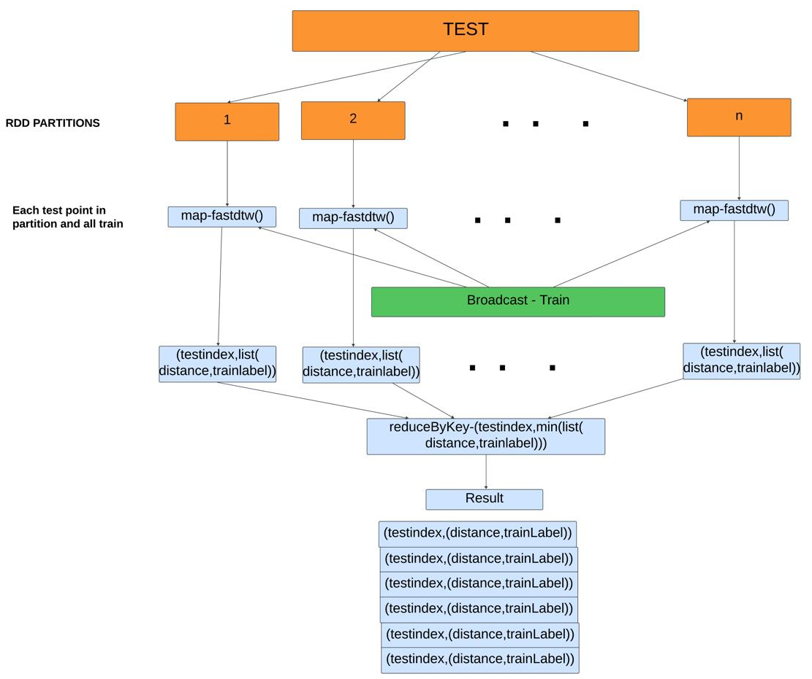
Model 2: Broadcasting
Notes:
Harnitha - <frame>

Slide 22
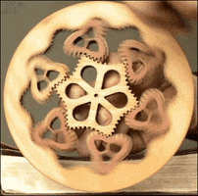
Hyper-Parameter Tuning
A simple ‘for loop’ iterating over different values of k recording time and accuracy.
We consider k = 5, 10, 20, 50, 70
Notes:
Harnitha

Slide 23

Results !!
Let’s dive in to see how well our models performed.
Notes:
Neeraj - <read>

Slide 24

Turbulent Learning Curve
Data Manipulation
The HAR data set is a processed data not RAW data from sensors. We don’t know the pre-processing already done. So, it is not feasible to perform any feature engineering or selection – given the high dimensionality.
Misclassification Tendency
The labels of Walking, Walking Up and Downstairs, Standing, Lying & Sitting are quite hard to differentiate due to high similarity, increasing chances of misclassification.
Shared Clusters Limitation
When multiple projects are under development, the resources are scarce enough to increase computational inefficiency.
Notes:
Harnitha & Emaan - Before we dive into results, let’s look at some of the problems we faced and what we learnt along the way.

Slide 25
Results
Computation Time
Non-PySpark Implementation incomplete after 1 ½ days for Traditional DTW.
PySpark based Traditional DTW simply kept crashing.
Euclidean KNN is slow. Taking roughly 20-25 mins to evaluate the entire test data of 2000 samples.
Fast DTW is relatively faster, taking about 16-18 mins. 🏆
Accuracy
For different values of ‘k’ DTW yields higher accuracy with lower computational time.
Euclidean KNN
K value | Accuracy | Time
5 | 29 % | 26 mins
10 | 30 % | 14 mins
20 | 31.7 % | 20 mins
50 | 33.1 % | 30 mins
70 | 33.6 % | 18 mins
Fast DTW KNN
K value | Accuracy | Time
5 | 29 % | 18 mins
10 | 31 % | 17 mins
20 | 33 % | 18 mins
50 | 33.8 % | 16 mins
70 | 34.5 % | 16 mins
Model 2 run-time was unstable ranging from 19 sec to 2 hrs yielding low accuracy.
Thus, making it unreliable.
Notes:
Emaan – if we implement without pyspark, we end up spending 1 ½ days for implementing traditional DTW. Pyspark based implementation kept crashing. Euclidean knn is slow, taking roughly 20-25 mins. Fast dtw on the other hand is faster, taking about 16-18 mins.
For different values of ‘k’ DTW yields higher accuracy with lower computational time.
Coming to Model 2, the run time is unstable, ranging from 19 sec to 2 hrs yielding low accuracy.

Slide 26
Computational Efficiency 🏆
1 ½ days
40% Reduction in Computation
15 mins
20 mins
Non PySpark
Euclidean KNN
Fast DTW KNN
Notes:
Harnitha - <frame>

Slide 27

Future Works
Exploring Non-Distance Metrics
Integrating Feature Selection Techniques for Time Series Analysis
Optimizing K Values for method 2
Implementing Advanced Algorithms like Time Warped Edit Distance (TWE) and Minimum Snap Matching (MSM)
Notes:
Shruti <read>

Slide 28


Thank you
Big Team 11
COMP4124 Big Data Learning & Technologies

